Slide 1



Custom Metal Box
MEMSDuino
Lafe Spietz
NIST
2024

Slide 2
Abstract
This is a custom metal box which contains the relay board that connects 90 volts to selected pins on a Dsub connector in the lid. The base of the box is attached to a wood board by 4 screws, and the 90 volt boost board is attached to the inside by means of a bracket screwed to the box. This box fully encloses the 90 volts at room temperature for safety.
MEMSDuino

Slide 3
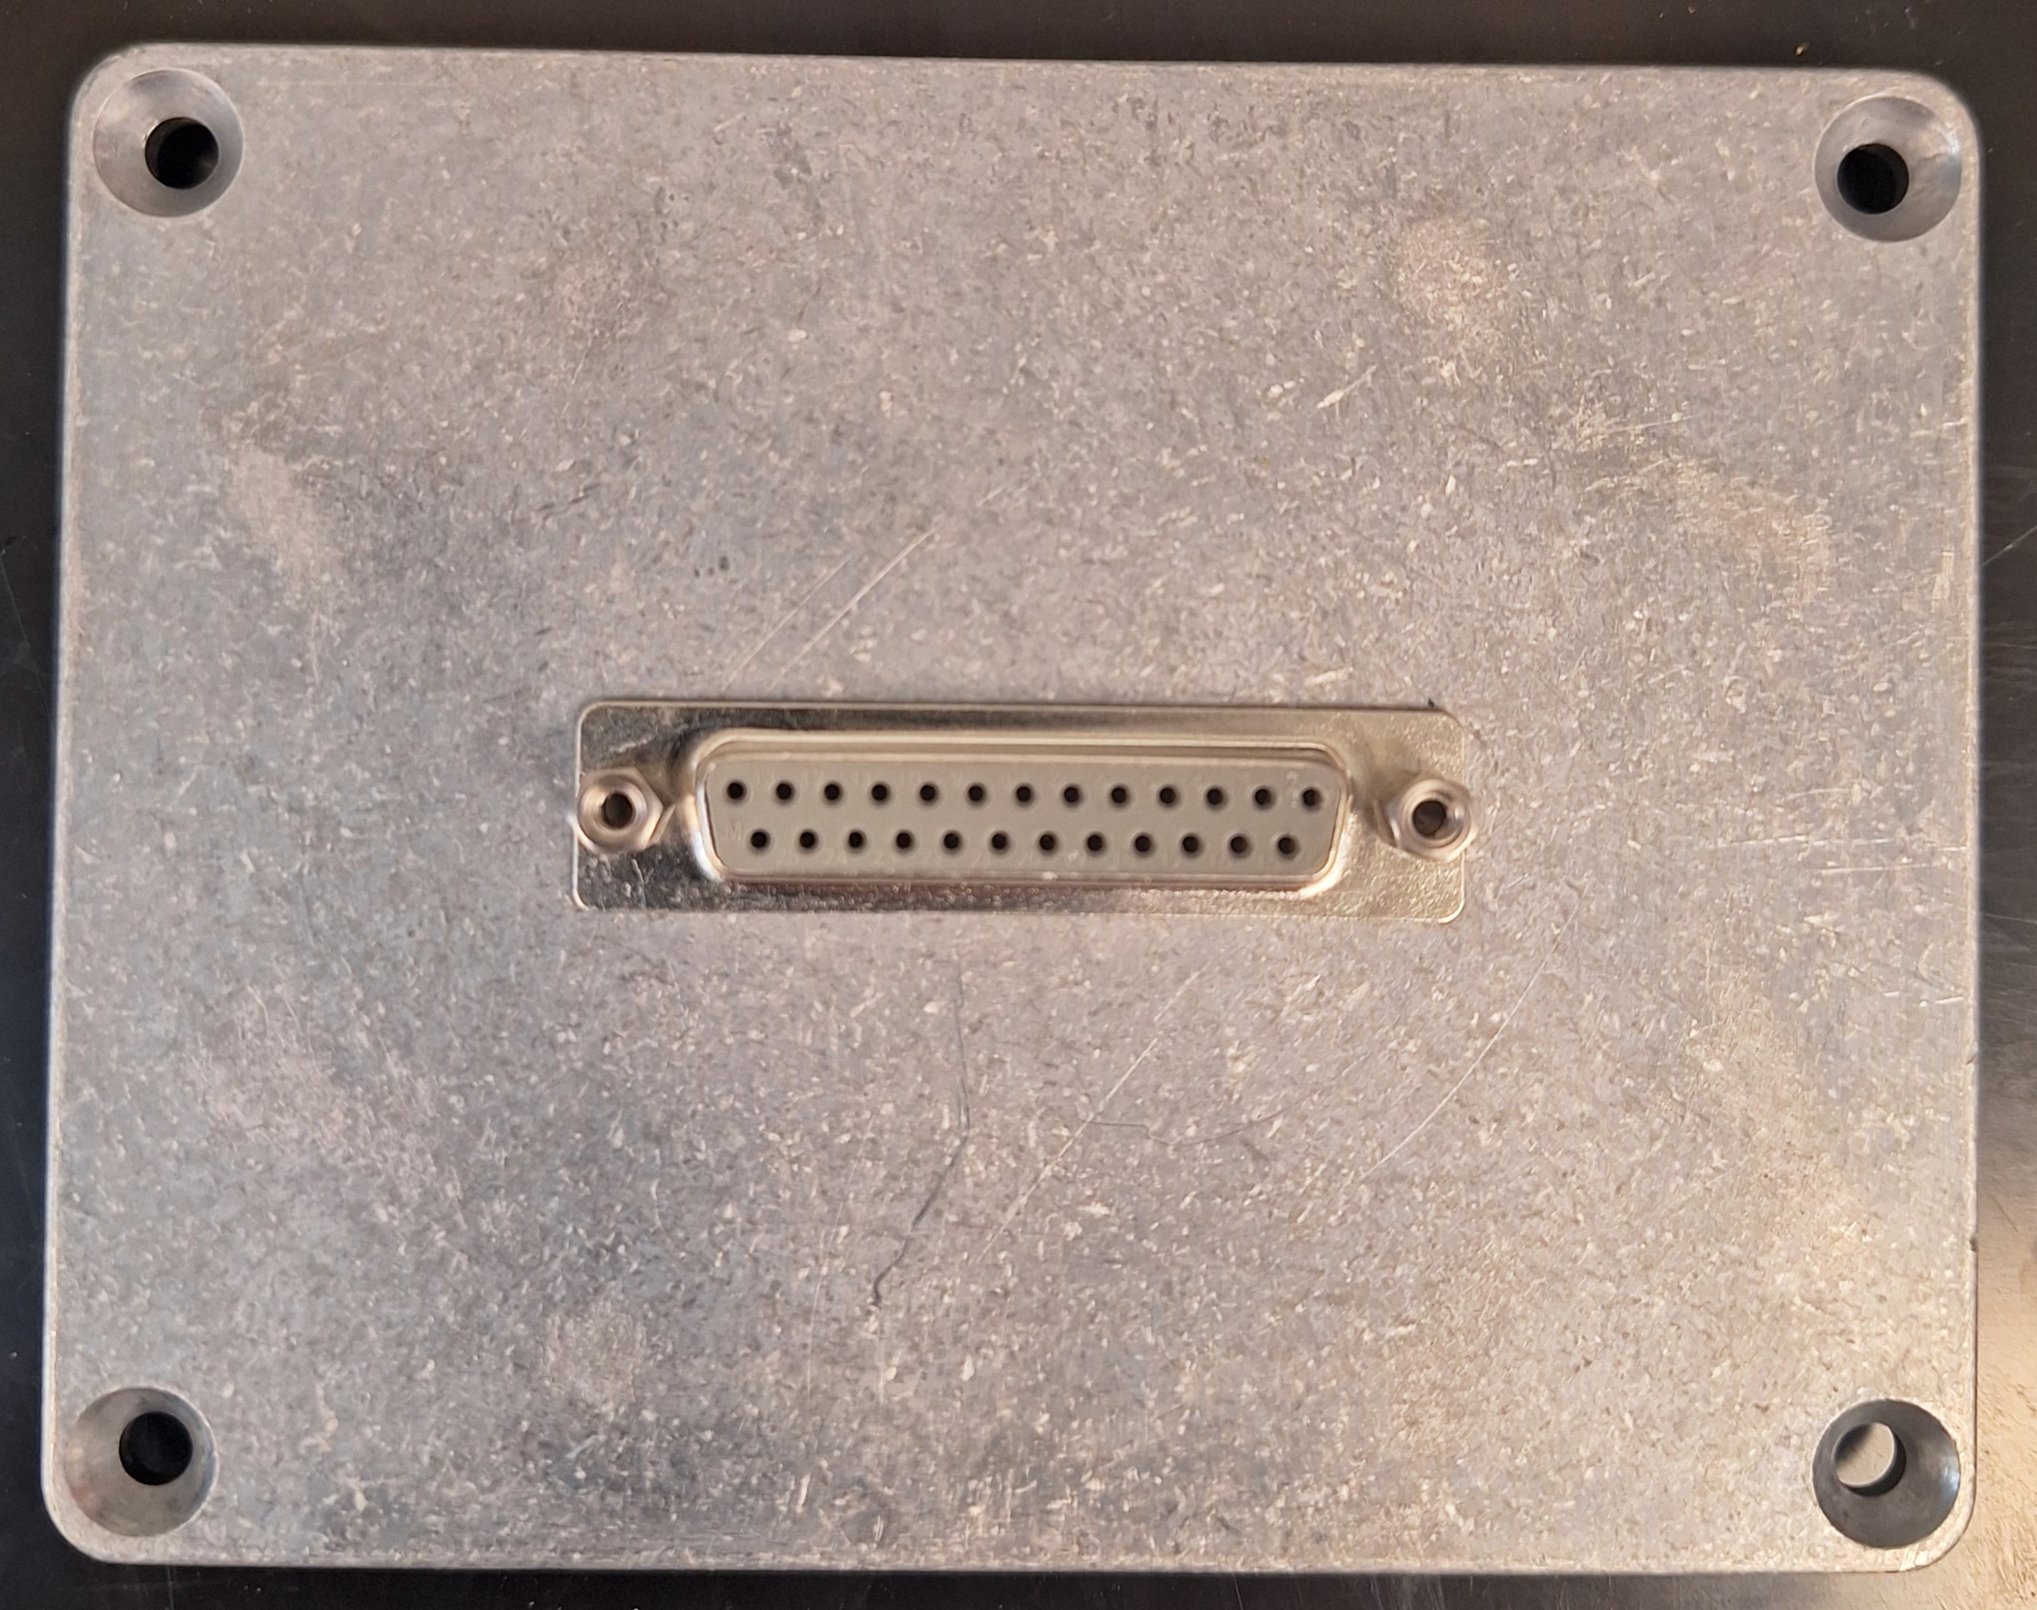
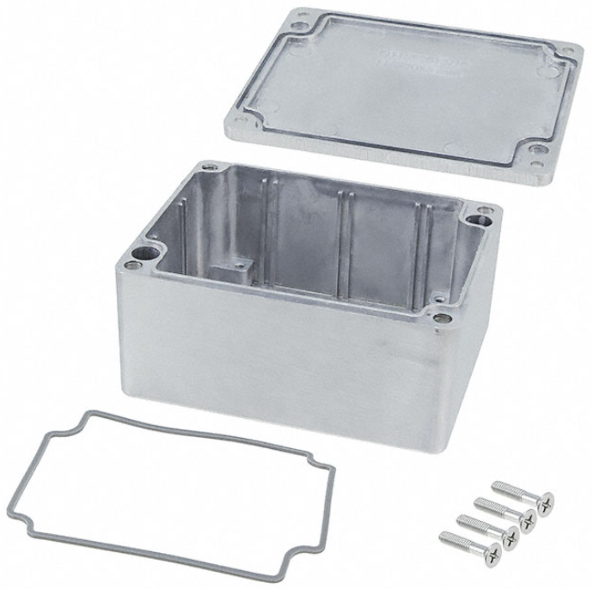
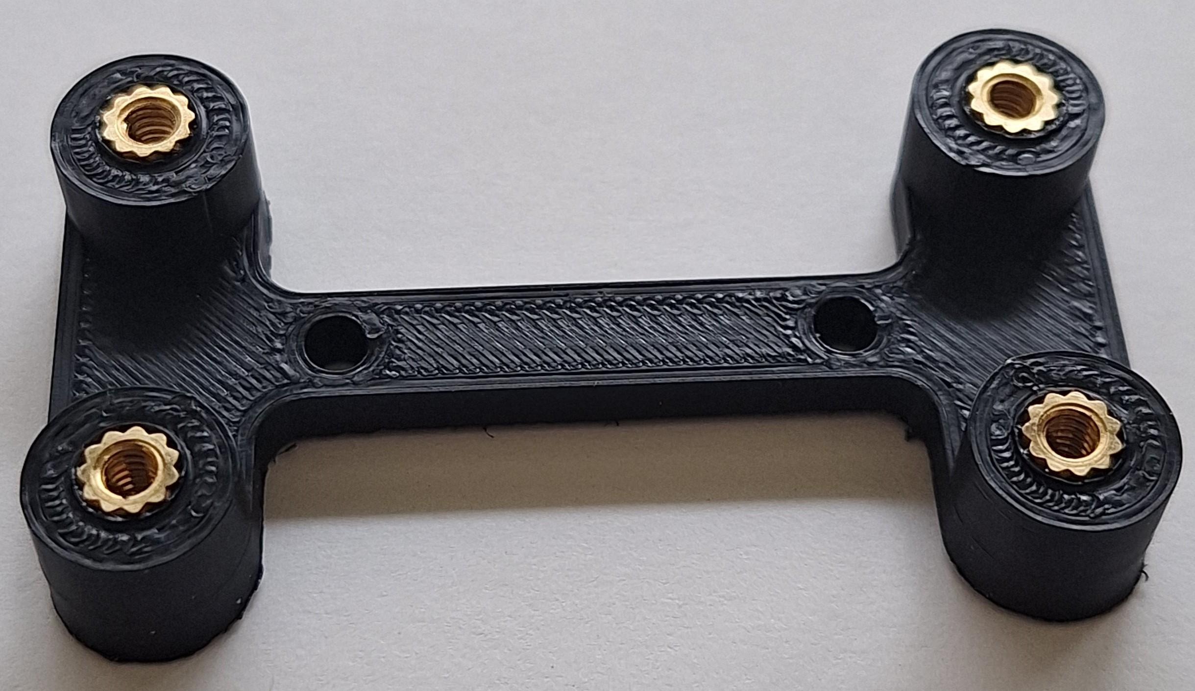
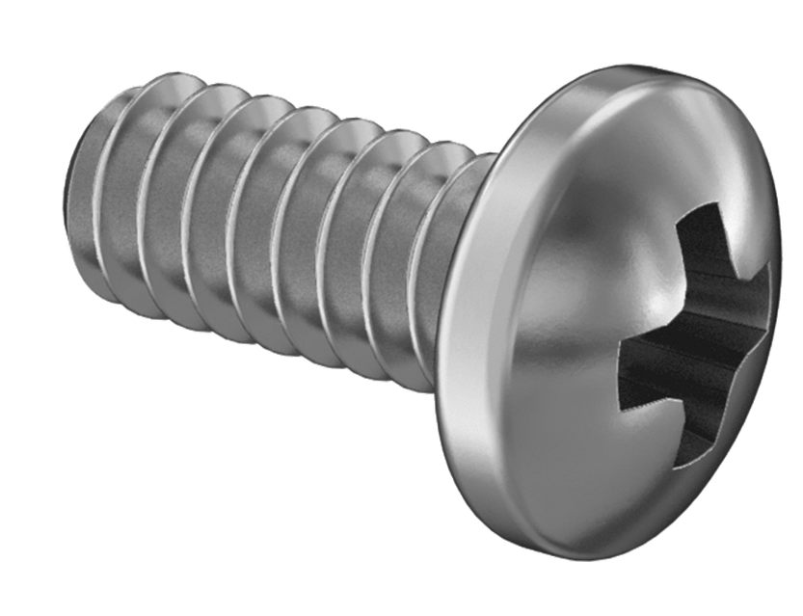
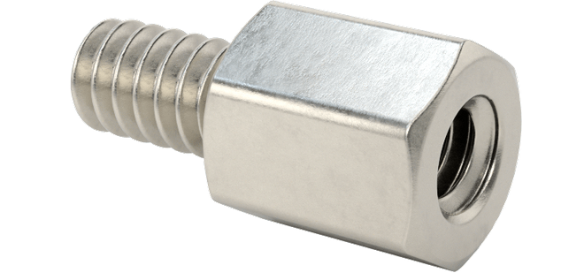
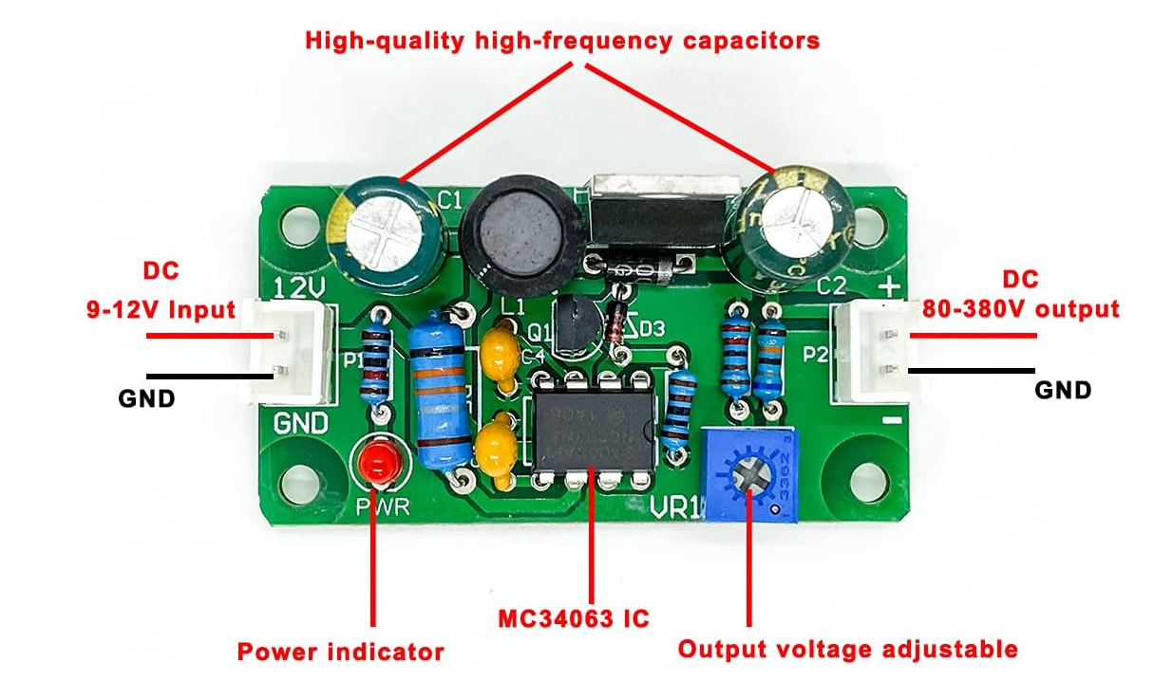
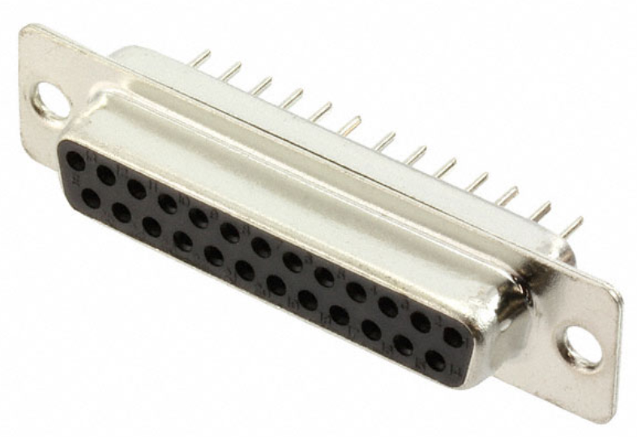
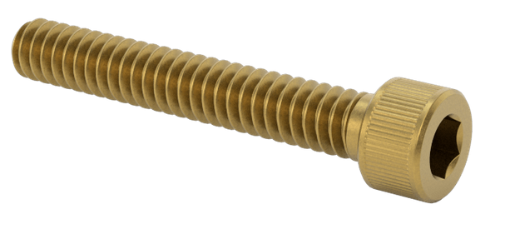
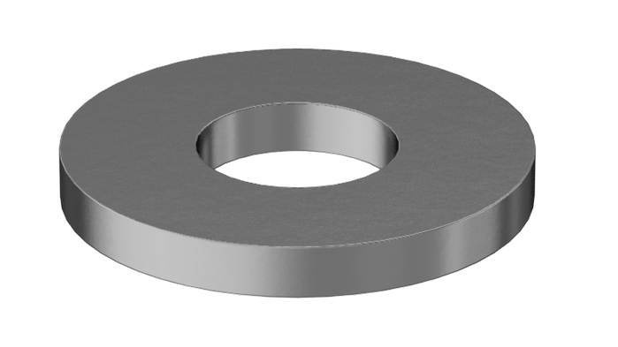
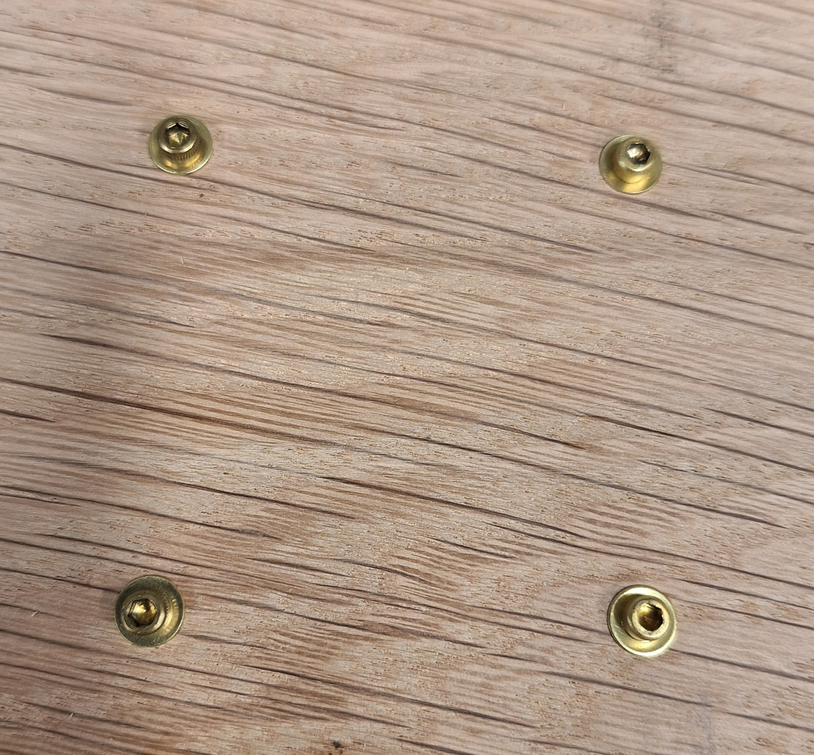
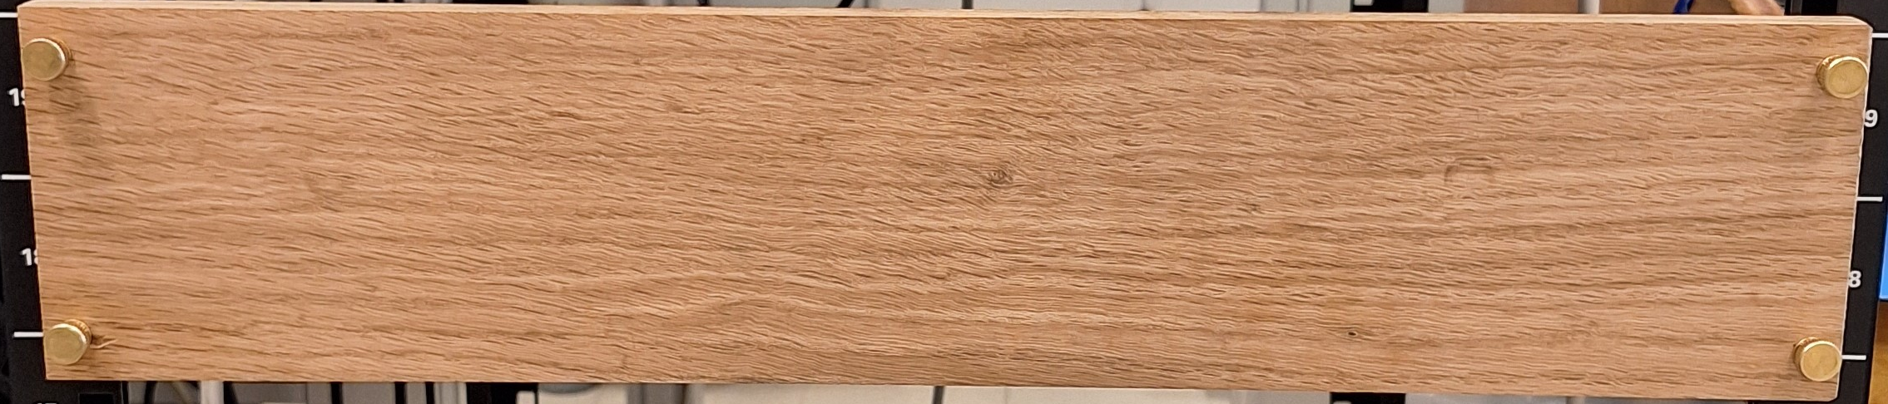
X6
X2
¼” 4-40 screws
HV-DCDC-bracket
7/32” 4-40 standoff
Bud AN-1304-A Diecast Aluminum Box
¾” 4-40 screws
X4
12V to 90 V Boost
#40 washers
Rack Mount Wood Board
MEMSDuino

Slide 4
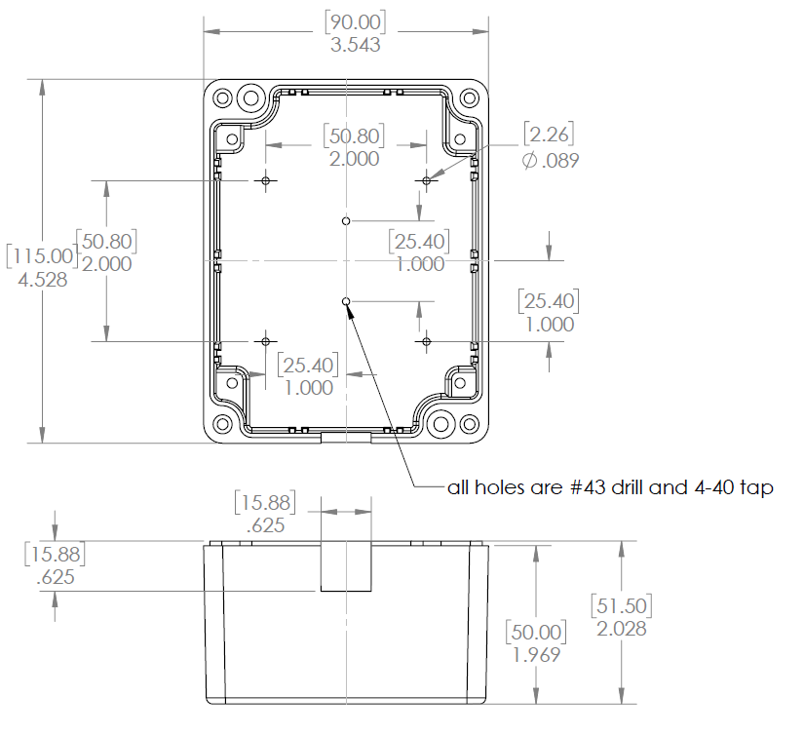
Modify or buy already-modified AN-1304-A box as follows:
MEMSDuino

Slide 5
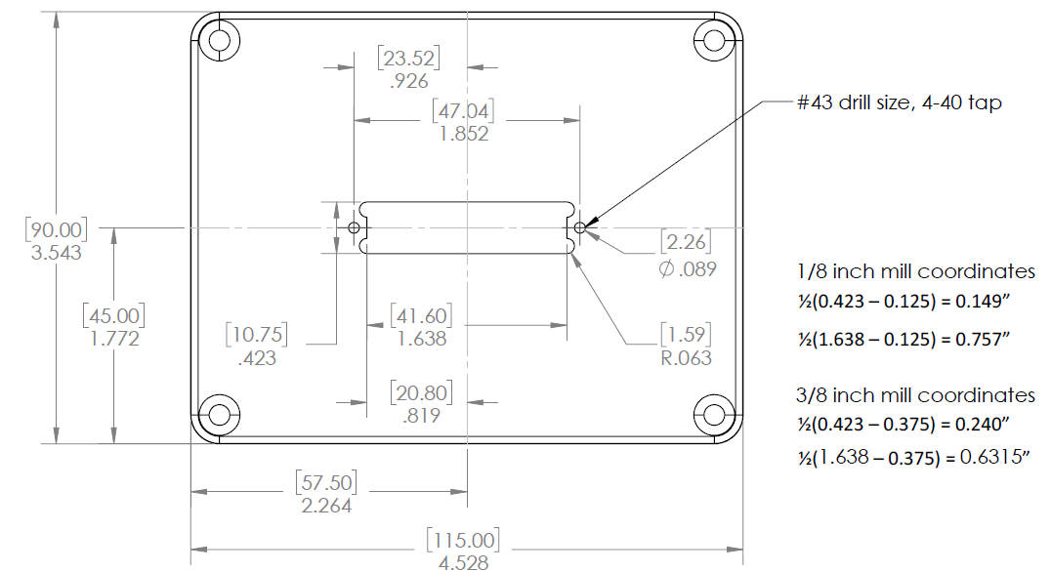
Modify or buy already-modified AN-1304-A lid as follows:
MEMSDuino

Slide 6
Screw DB25 Connector to lid using 7/32” 4-40 standoffs:
MEMSDuino

Slide 7
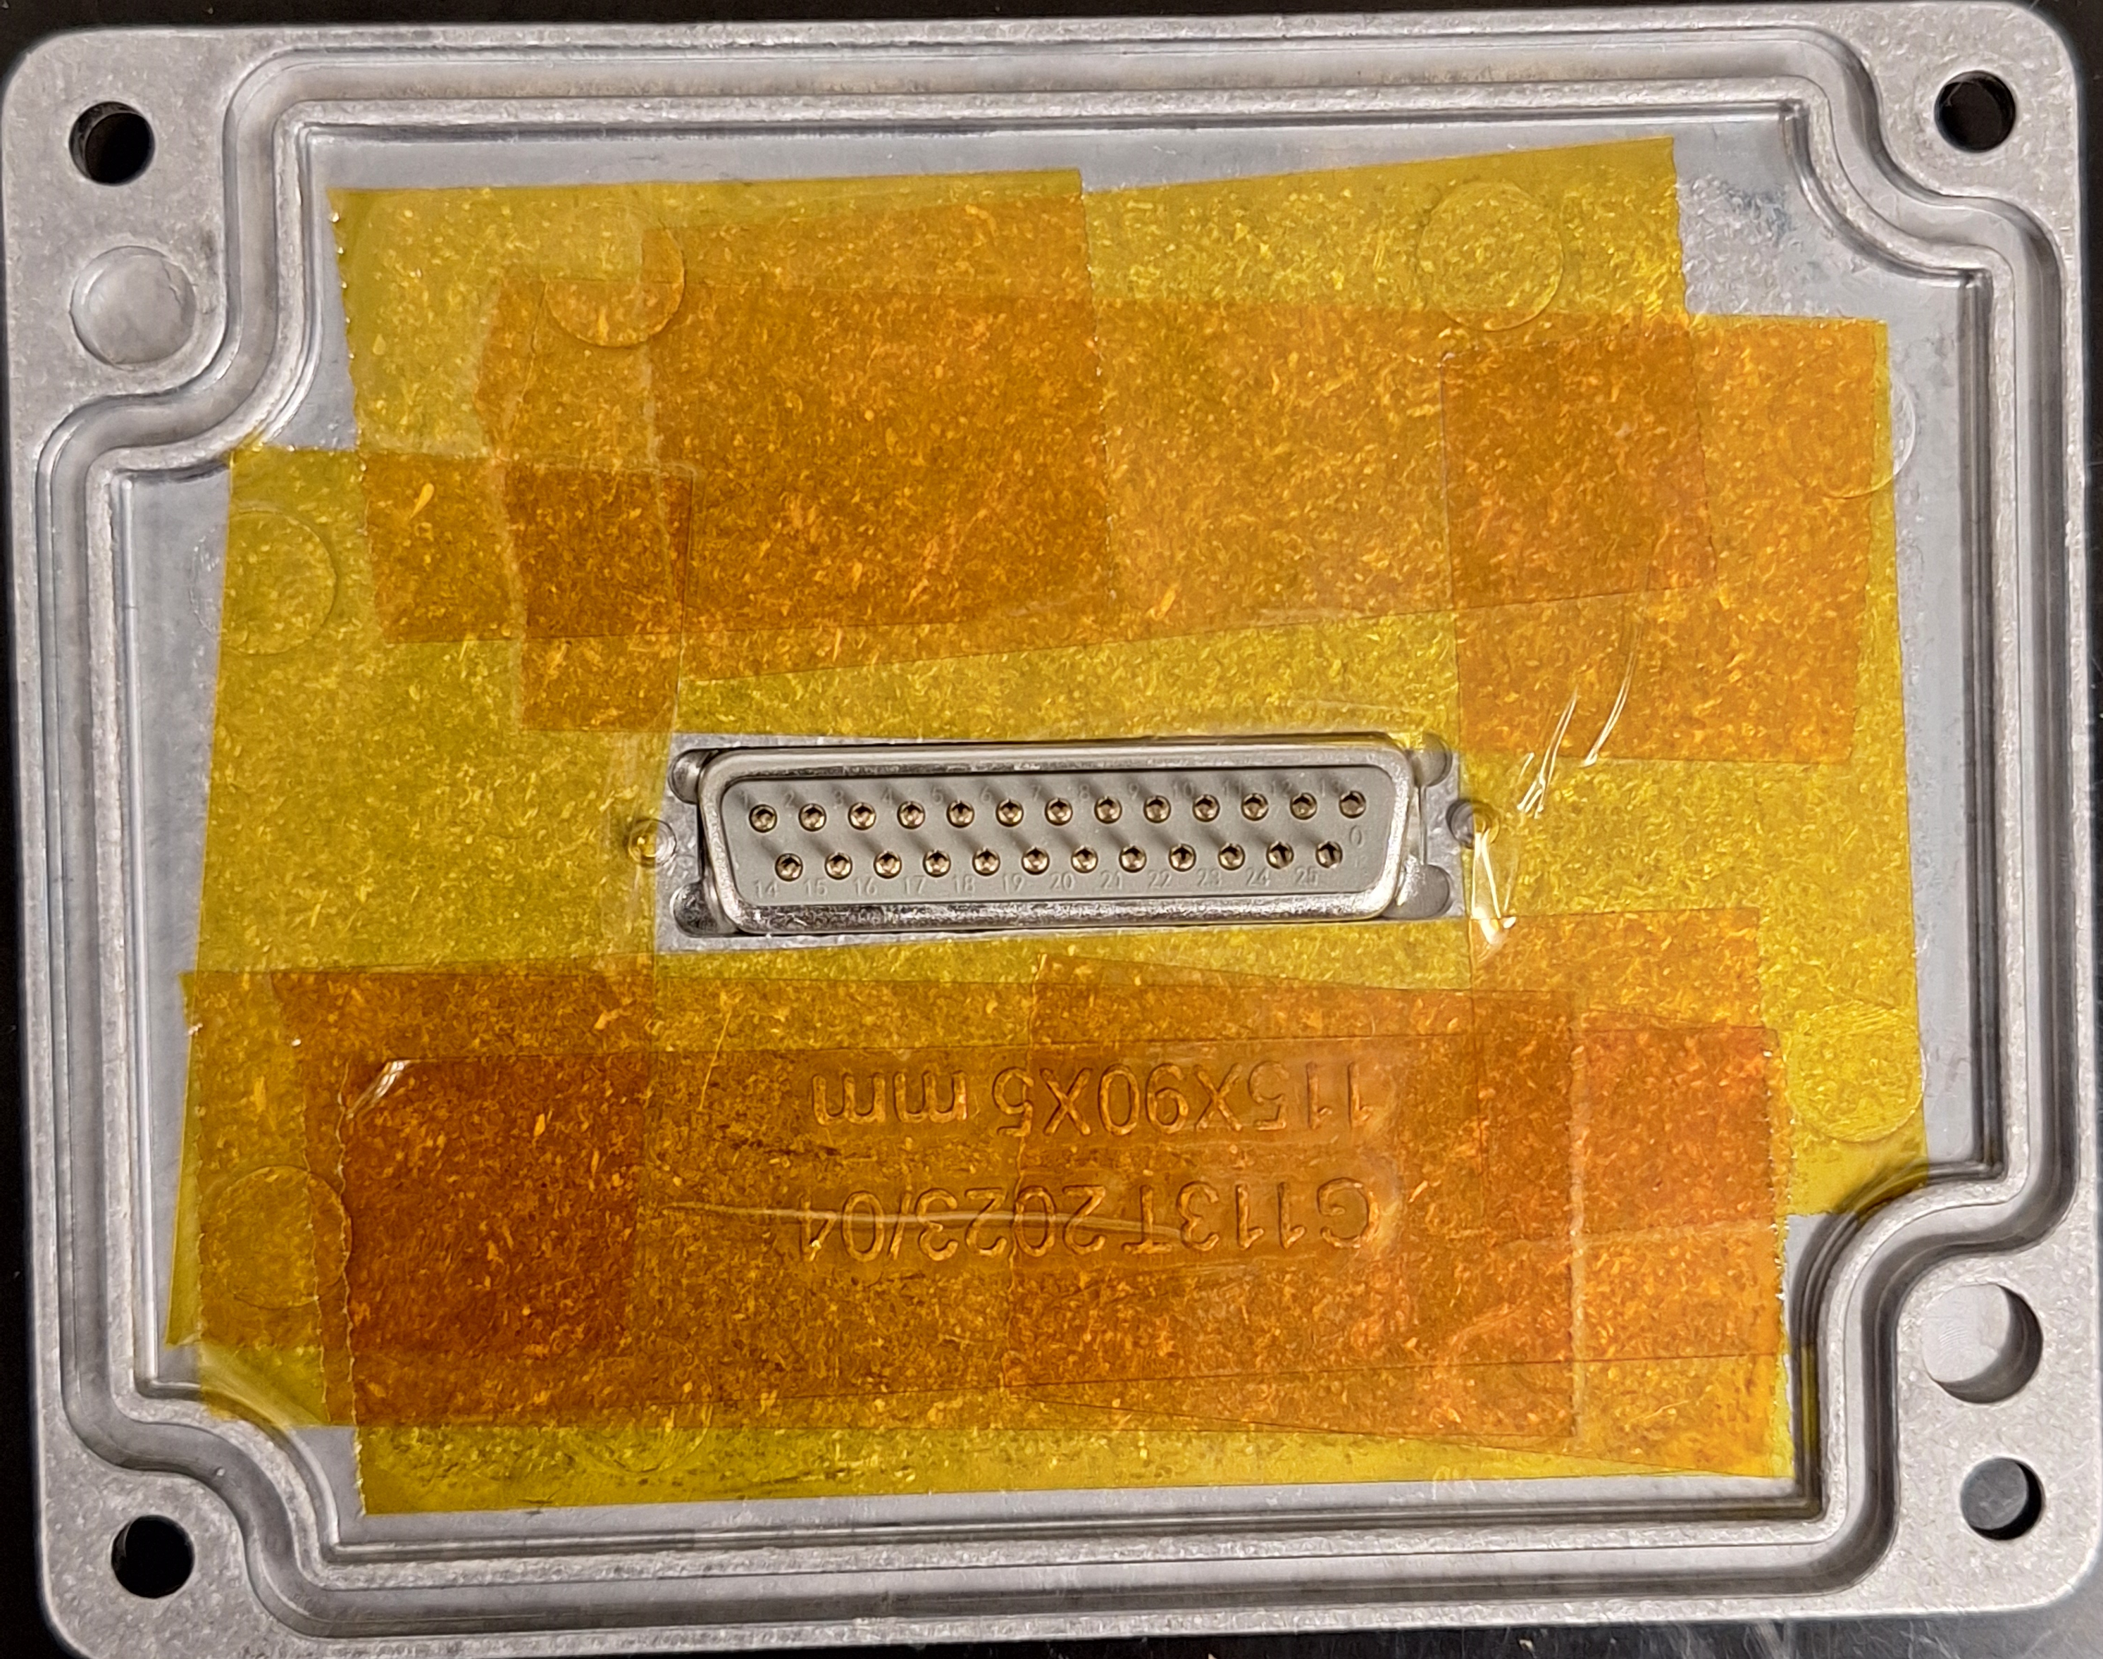
Add polyimide tape to lid to prevent possible shorts
MEMSDuino

Slide 8
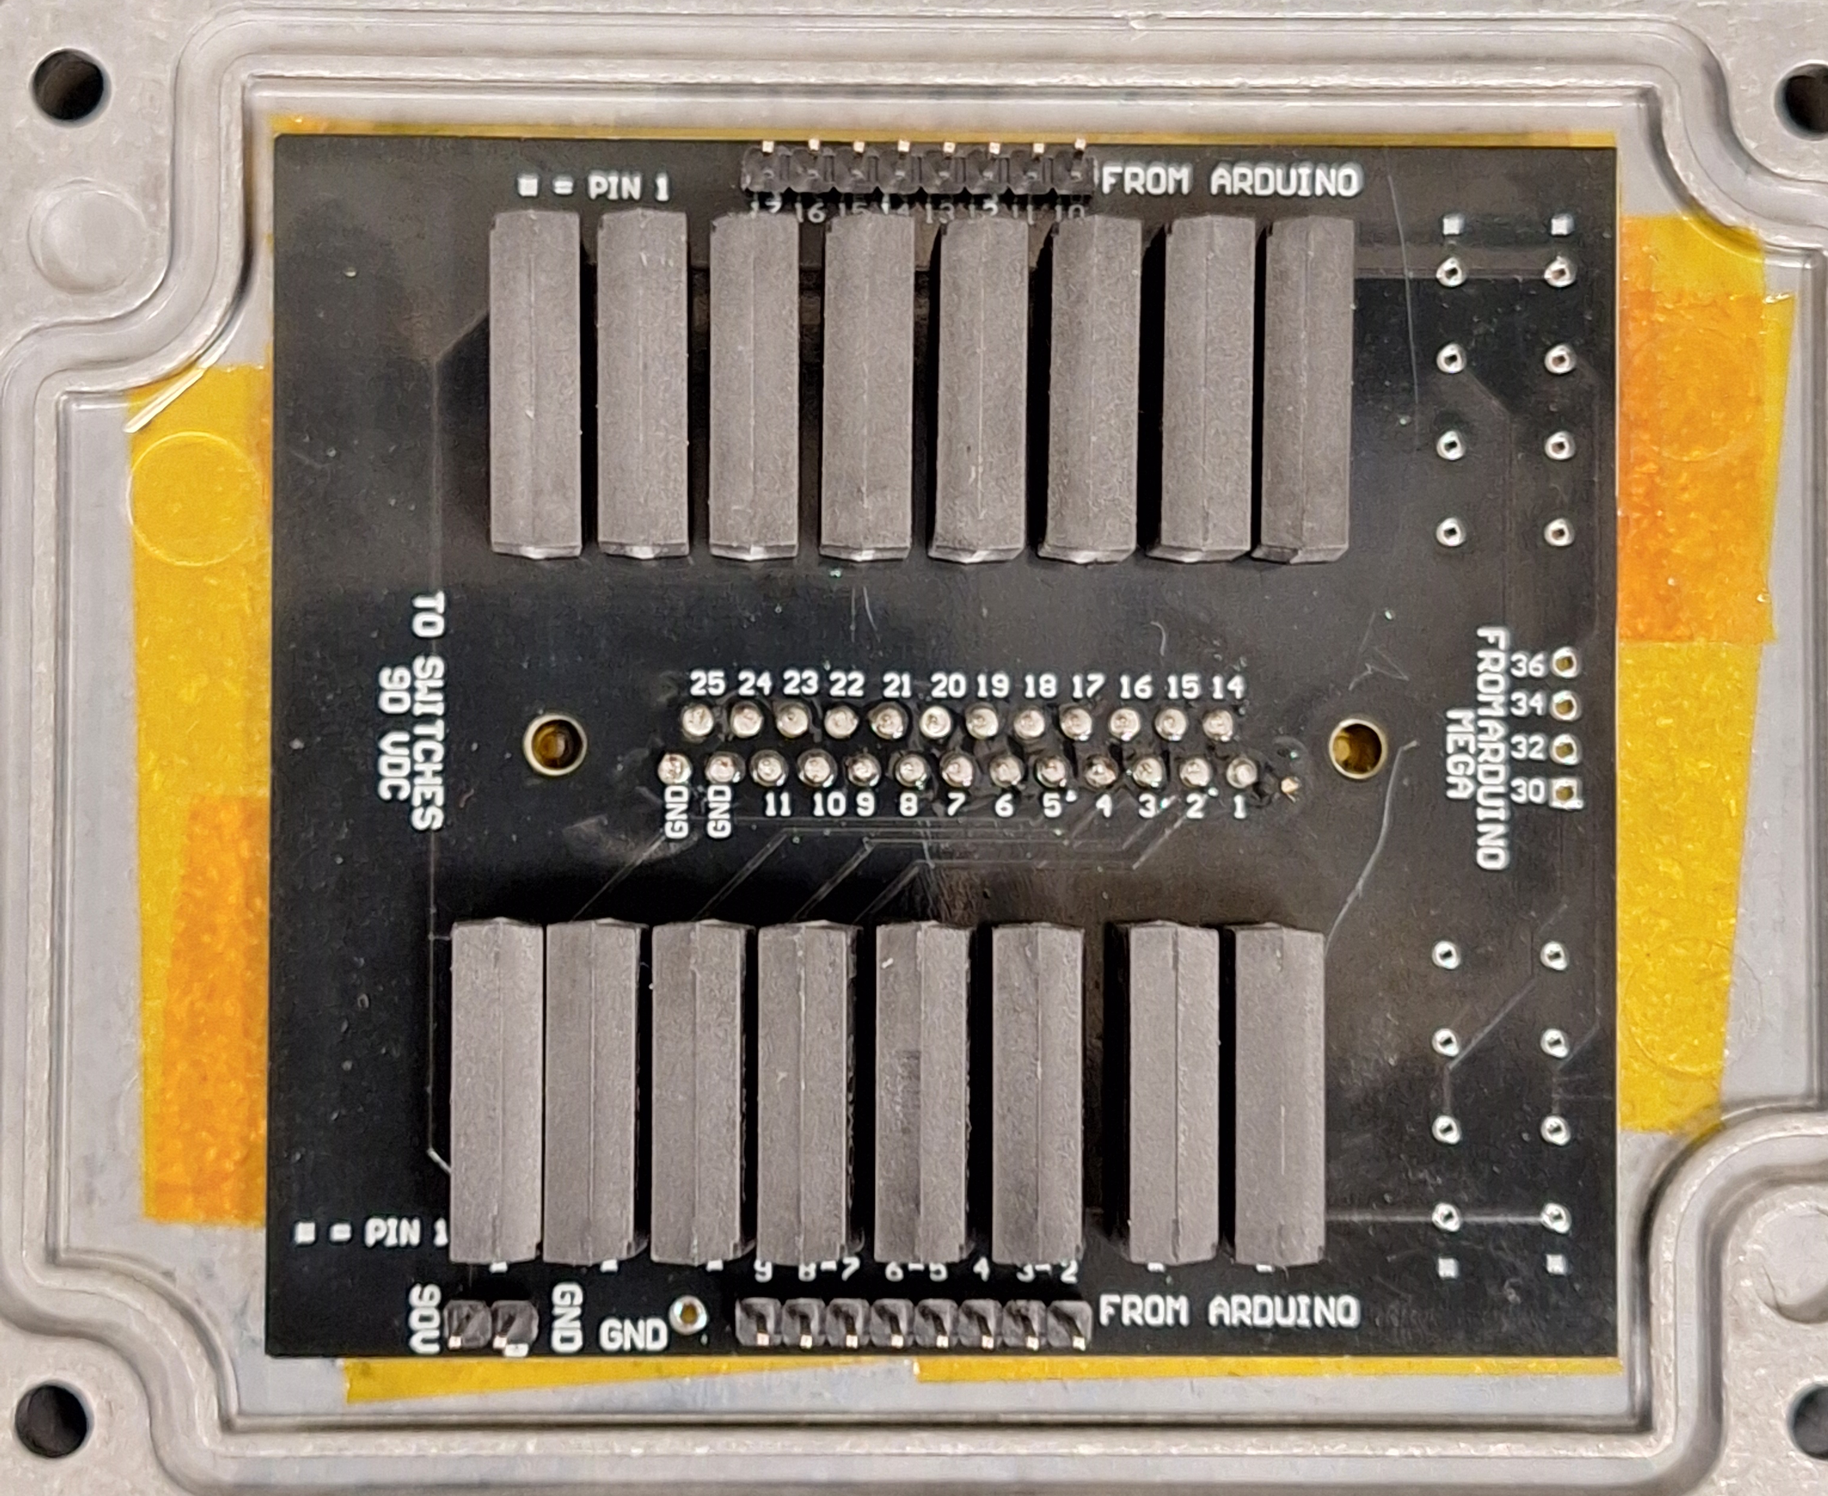
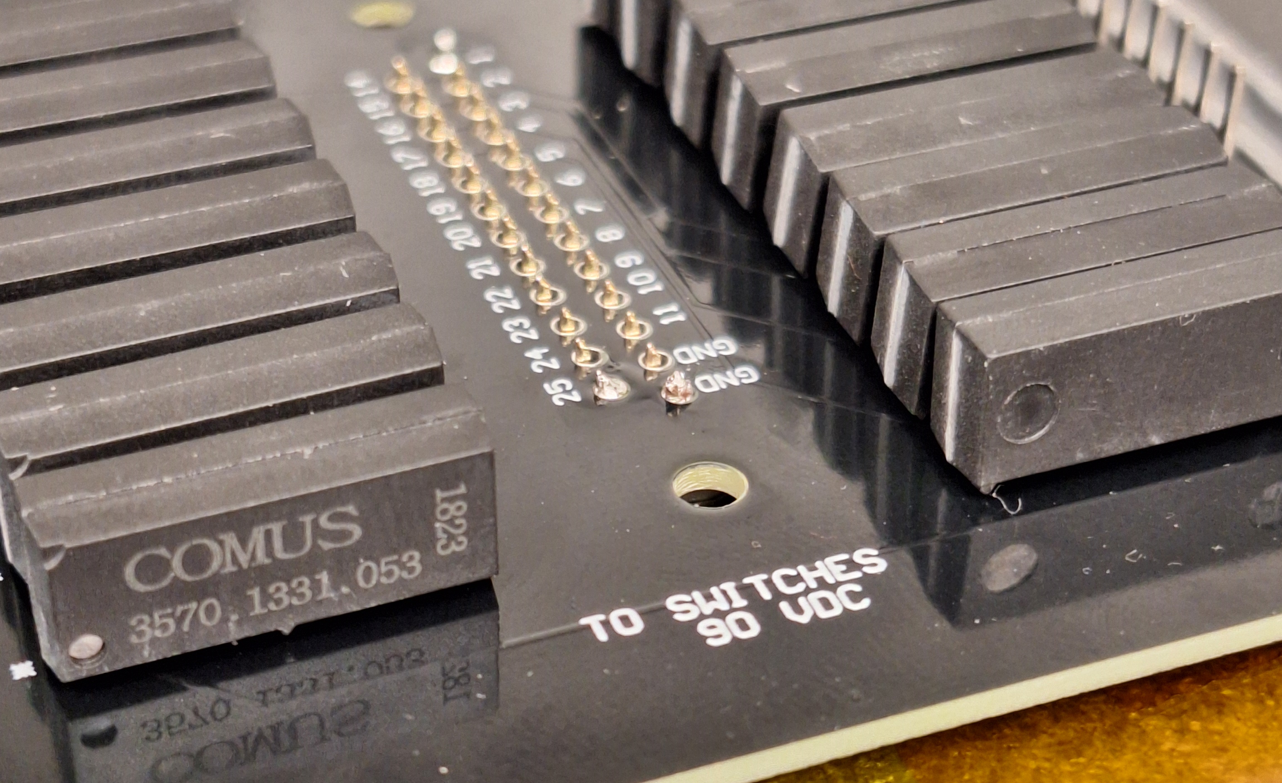
Solder already-assembled DB25 relay circuit board to DB25 connector, adding some space deliberately along the pins
MEMSDuino

Slide 9
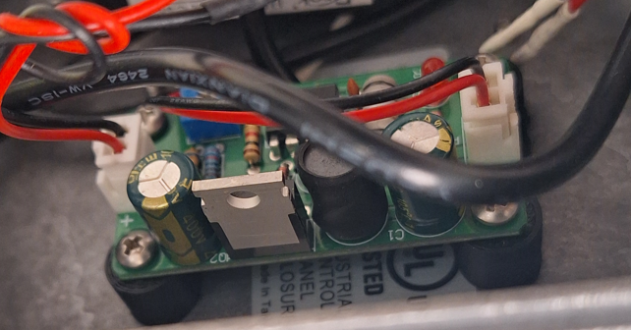
Use 4-40 screws to assemble the DCDC HV mounting bracket to the box, and the high voltage boost board to the bracket
X6
MEMSDuino

Slide 10
Use ¾” 4-40 screws to attach the main box to the wood board, with washers for each screw:
X4
Be sure to orient box so that hole for cables points towards Arduino.
MEMSDuino

Slide 11
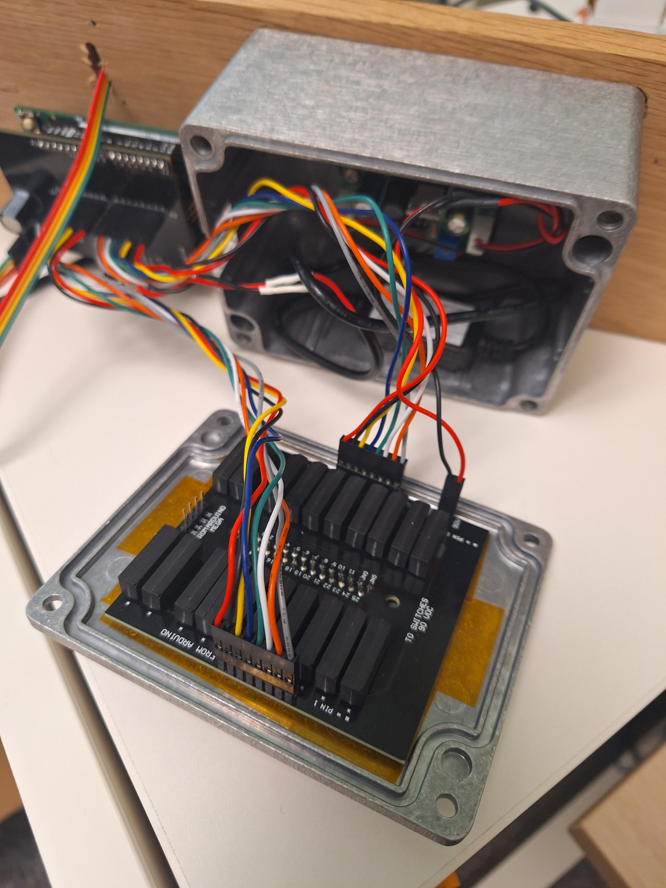
Assemble cables, matching red wire to lowest pin number on both ends, being careful to keep track of which 8 pin cable is which.
MEMSDuino

Slide 12
Conclusions:
The captive circuit board is not ideal, and a better design might make this slightly mor modular. It would also be useful if someone were to get these made in some volume and sold fully machined.
MEMSDuino

